Slide 1
JavaScript Reference
https://developer.mozilla.org/en-US/docs/Web/JavaScript/Reference

Slide 2
Array Functions
length
push
pop
unshift
shift
indexOf
splice
slice
reverse
sort

Slide 3
Assignment 1
Create a Queue (FIFO) in JavaScript
It should have three methods
Enqueue
Dequeue
Printqueue

Slide 4
Primitive Wrappers
Primitive Wrappers are available for only Three Primitive Data Types in JavaScript
Boolean
String
Number
Null
Undefined

Slide 5
Boolean Wrapper
var myBoolean = new Boolean (true | false) ;
For any of these wrappers valueOf ( ) function will return it's primitive value

Slide 6
String Wrapper
var myString = new String (' Hello, IJSE ') ;
Functions and Properties of String Wrappers'
length
charAt
charCodeAt
indexOf
toLowerCase
toUperCase
trimLeft
trimRight
trim
split
substring
substr

Slide 7
Number Wrapper
var myNumber1 = new Number (10) ;
var myNumber2 = new Number (10.25) ;
Functions and Properties of Number Wrappers'
[Global|Number] isNaN
[Global|Number] isFinite
isInteger
toExponetial
toFixed
toPrecision

Slide 8
Big.js
JavaScript uses double-precision 64-bit IEEE 754 floating point for numbers. Threfore, this data type should never be used for precise values, such as currency. For that, you will need to use the Big.js instead.
https://github.com/MikeMcl/big.js/

Slide 9

Strange Behaviors in JS
typeof null
returns Object even though null is a primitive data type
"IJSE".toLowerCase()
var number1 = 10;
number1.toFixed(2);
Do primitive types have methods and properties in JS ?

Slide 10
What is DOM ?
DOM stands for Document Object Model

Slide 11
The Document Object Model (DOM) is a programming interface for HTML and XML documents. It provides a structured representation of the document and it defines a way that the structure can be accessed from programs so that they can change the document structure, style and content. The DOM provides a representation of the document as a structured group of nodes and objects that have properties and methods. Essentially, it connects web pages to scripts or programming languages.
A Web page is a document. This document can be either displayed in the browser window, or as the HTML source. But it is the same document in both cases. The Document Object Model (DOM) provides another way to represent, store and manipulate that same document. The DOM is a fully object-oriented representation of the web page, and it can be modified with a scripting language such as JavaScript.

Slide 12
<!DOCTYPE html>
<html>
<head>
<title>Learning DOM</title>
</head>
<body>
<h1>DOM</h1>
<div>
<ul>
<li>HELLO</li>
<li>DOM</li>
</ul>
</div>
</body>
</html>
html
head
body
title
h1
div
ul
Nodes
li
li
DOM Tree

Slide 13
DOM API Reference
https://developer.mozilla.org/en-US/docs/Web/API
https://developer.mozilla.org/en-US/docs/Web/API/Document_Object_Model

Slide 14


Slide 15
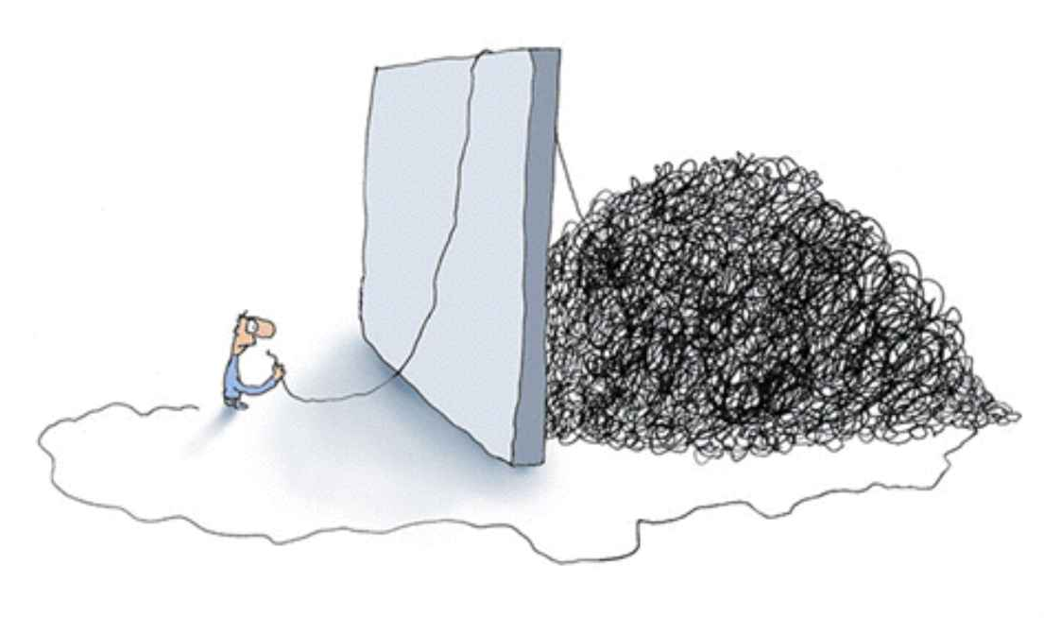
What is jQuery ?
jQuery is a JavaScript Framework which helps to manipulate the DOM easily .
So when dealing with the DOM, don't try to seperate jQuery as something you inject externaly. Instead, try to see it as a something that has attached with the DOM already.
So, if you use DOM, you do it through the jQuery.
Since jQuery, This is how we see DOM
jQuery
Real DOM

Slide 16
It is time to download :-)
http://jquery.com/

Slide 17

jQuery is all about
RS
But if you want, you can change it to
:)

Slide 18
Basic jQuery Usage
.
Then do whatever you want to do with it
( '#div1>ul>li' )
It is identical to how we use selectors to select elements in CSS

Slide 19
4 - "Most Used" jQuery Functions
text ( [ value ] )
html ( [ value ] )
css ( [ value ] )
attr ( [ value ] )

Slide 20
When dealing with forms though...
val ()
submit ()

Slide 21
Events
Global Events
https://developer.mozilla.org/en-US/docs/Web/API/GlobalEventHandlers
Specified Events
Event Name
Usage :-
$ ( " btnLogin " ) . on ( " click " , function_name ) ;
Remeber, this function has "Event Data" parameter

Slide 22
More about Events
jQuery has formalized some frequently used events for ease in use.
click(function)
dblclick(function)
foucs(function)
blur(function)
keydown(function)
keyup(function)
keypress(function)
mousedown(function)
mouseup(function)
mousemove(function)

Slide 23
Traversing & Manipulation
"Commonly Used" Traversing & Manipulation Functions
Traversing
Manipulation
contents
find
parent
first
last
append
prepend
clone
remove
replaceWith

Slide 24
jQuery Documentation
http://api.jquery.com/

Slide 25
Timers in JavaScript
var intervalId = setInterval ( function [, delay, param1, param2, param3, ... ] ) ;
clearInterval ( intervalId ) ;
var timeoutId = setTimeout ( function [, delay, param1, param2, param3, ... ] ) ;
clearTimeout ( timeoutId ) ;

Slide 26
Creating Objects with Object Literal
var myObj = { } ;
console.log (myObj) ; // Print Object

Slide 27
Working Files
From Today On, Working Files can be downloaded through IJSE web site.
http://workingfiles.ijse.lk/

